Slide 1









PROCEDURE TEXT
by Tiur Roganda

Slide 2




Purpose of study
3.4 Membandingkan fungsi sosial, struktur teks, dan unsur kebahasaan beberapa teks prosedur lisan dan tulis dengan memberi dan meminta informasi terkait resep makanan/ minuman dan manual, pendek dan sederhana, sesuai dengan konteks penggunaannya 4.4 Menangkap makna secara kontekstual terkait fungsi sosial, struktur teks, dan unsur kebahasaan teks prosedur lisan dan tulis, sangat pendek dan sederhana, dalam bentuk resep dan manual

Slide 3





WHAT DO WE NEED TO KNOW
WHAT ARE THE FUNCTIONS OF PROCEDURE TEXT?
WHAT ARE THE PARTS OF PROCEDURES TEXT?
WHAT ARE THE LANGUAGE FEATURES?
WHAT IS PROCEDURE TEXT?

Slide 4
01. WHAT IS PROCEDURE TEXT
Procedure Text is a kind of text that shows how to make something or how to do something.

Slide 5

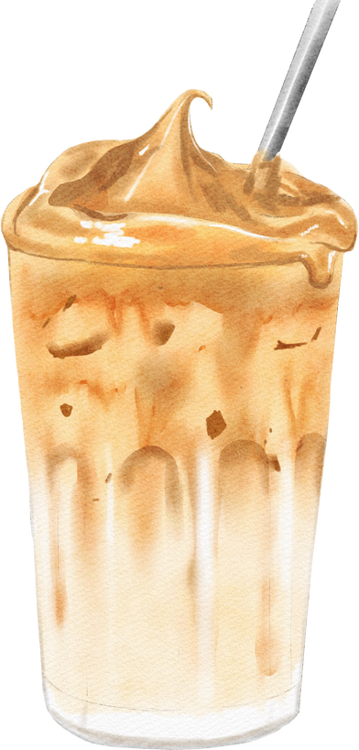
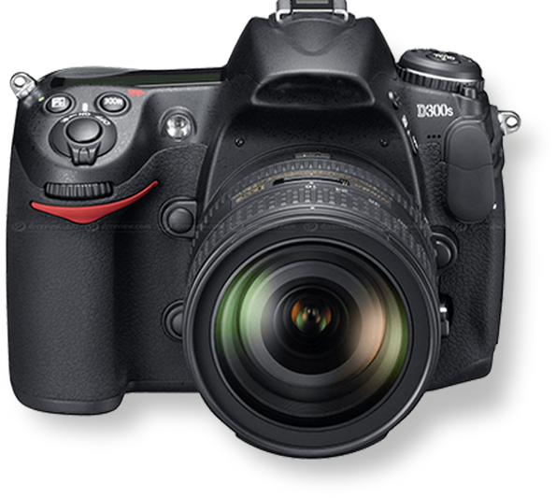
Examples :
Food
Drink
Manual
How to make Dalgona Cofee
How to make donuts
How to Operate DSLR Camera

Slide 6




02. What are the functions of the procedure text
...to get the best result effeciently
...to avoid accidents, damage, unnecessary waste

Slide 7
How to make Donuts
( Aim / Goal )
01. Tools
  bowl
  spatula
  Frying pan
03. Steps
02. Materials / Ingredients
  First, mix the flour, baking powder, and instant yeast well.
  Second. add margarine, salt, eggs, sugar, and fresh milk. Mix using hand. Stop when it's not sticky to our hand. Let it for 30 minutes.
  Then, take the gas out and shape the donuts. Let it again for 15 minutes
  Fry in medium heat until the color brownish.
  Finally it is ready to serve.
  400 grams of high protein
wheat flour
  100 grams of medium protein wheat flour.
  A half tsp of baking powder.
  15 grams instant yeast.
  70 grams of margarine.
  A half tsp of salt.
  2 eggs
  100 grams of sugar
  200 ml of fresh milk.
03. steps
Add a subheading

Slide 8
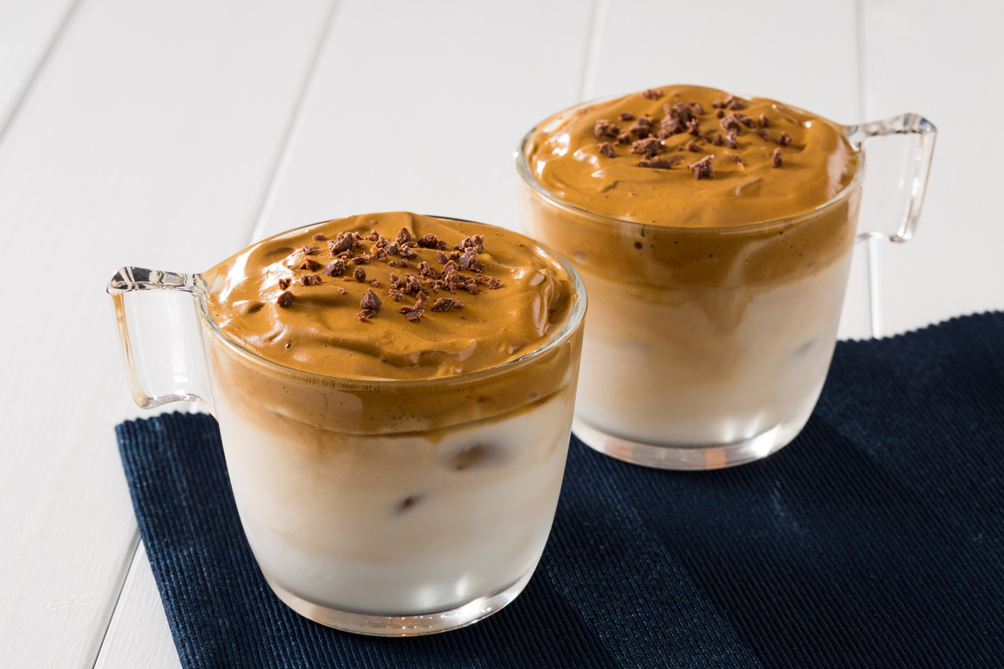
How to make Dalgona Cofee
( Aim / Goal )
01. Tools
  whiskar
  glass
  spoon
03. Steps
02. Materials / Ingredients
  First, mix the coffee, sugar and water in the glass until creamy.
  Second, pour the milk into the glass.
  After that add some ice cubes
  Then stir them well.
  Finally, it is ready to serve.
  a spoon of istant black coffee
  2 spoon of sugar
  a spoon of water.
  200 ml fresh milk.
  ice cubes
03. steps
Add a subheading

Slide 9
How to operate camera
Steps
  First, Hold up the camera and centre the object in the LCD
  Second, move closer or use the zoom control for the result you want.
  Third, when you are ready to take the picture, hold the shutter halfway.
  Then, a light should appear that lets you know the camera is set to go.
  Lastly, press shutter all the way down.

Slide 10
PARTS (STRUCTURE ) OF PROCEDURE TEXT
STEPS
AIM / GOAL
TOOLS / EQUIPMENTS
INGREDIENTS

Slide 11






LANGUAGE FEATURES
  Use adverbial of sequence / Using temporal conjunction (e.g: first, second, third, the last
  Use command / imperative sentence (e.g : put the noodles on the . . cut the onion. . .,wash the tomatoes. ..)
  Using adverbials (Adverbs) to express detail the time, place, manner accurate, for example, for five minutes, 2 hours, etc.
  Using action verbs, e.g : make, take, boil, cook
  Using Simple Present Tense

Slide 12

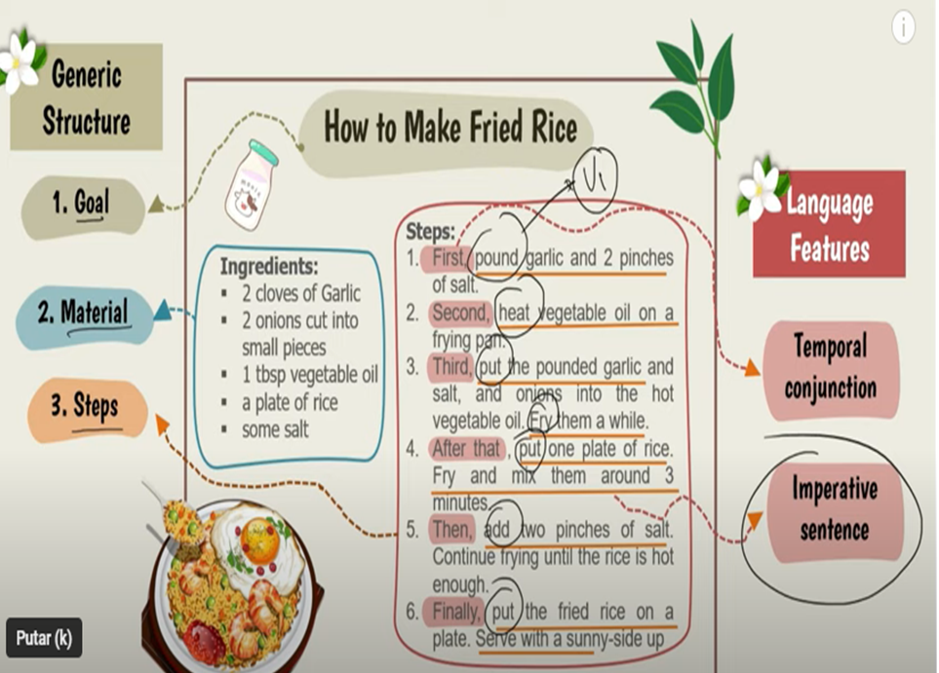

Slide 13





THANK YOU
See you next time!

